Slide 1
Object Oriented Analysis and Design for Information Systems: using UML, OCL and IFML for modeling
Prof. Raul Sidnei Wazlawick

Slide 2
Contents
Introduction
Business modeling
High level requirements
Use case based project planning
Expanded use cases
Conceptual modeling – fundamentals
Conceptual modeling – patterns
Functional modeling with OCL contracts
Domain tier design
Code generation
Test
Interface tier design
Data persistency

Slide 3
Functional Modeling
Introduction
Preconditions
Query return
Post Conditions
Exceptions
Pattern Contracts for CRUD
Pattern Contracts for Listing Objects
Contracts Related to Use Cases

Slide 4
Functional Modeling Entries
The refined conceptual model, which represents statically the information managed by the system.
The expanded use cases or system sequence diagrams which show how potential users exchange information with the system.

Slide 5
System Operations
Commands
Queries

Slide 6
System Command Contract
Preconditions (optional).
States what is assumed to be true by the command and therefore should not be checked by it.
Post conditions (mandatory).
States how the command changes existing information if it is successfully executed.
Exceptions (optional).
States what conditions that could prevent the command from succeeding will be checked by it.

Slide 7
System Query Contract
Preconditions (optional).
States what is assumed to be true by the query and therefore should not be checked by it.
Results (mandatory).
Defines the information that the query returns.
Exceptions (optional).
States the conditions that were added by the designer to prevent the query to be performed in some situations.

Slide 8
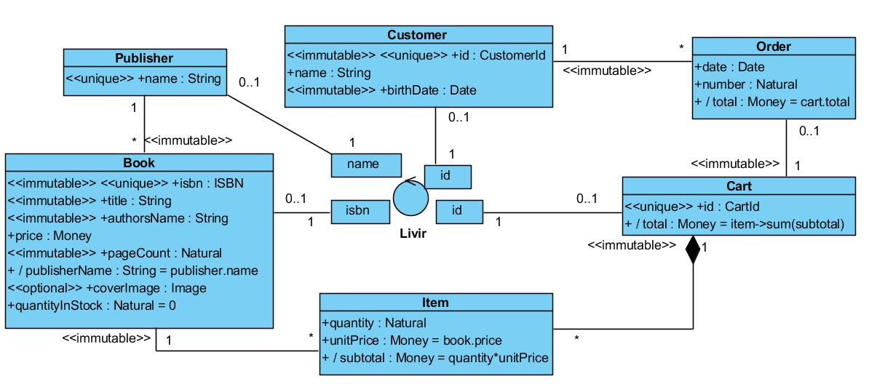
Reference Conceptual Model

Slide 9
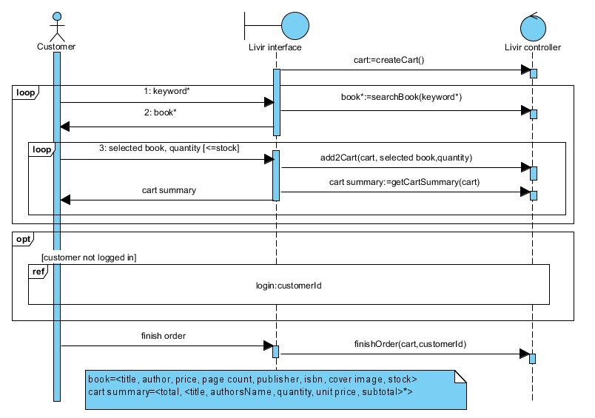
Reference System Sequence Diagram

Slide 10
Operations
createCart():CartId
It is a command that creates a new empty instance of Cart and assigns an identifier to it. It returns the identifier.
searchBook(keywords:Set[String]):OrderedSet[Tuple]
It is a query that returns an ordered set of tuples that contains information about the books that are relevant to the search. Each tuple has title, author’s name, price, page count, publisher name, isbn, cover image, and quantity in stock for a book.
add2Cart(aCartId:CartId, anIsbn:Isbn, aQuantity:Natural)
It is a command that creates a new instance of Item and links it to the cart and book identified by the parameters.
getCartSummary(aCartId:CartId):OrderedSet[Tuple]
It is a query that returns an ordered set of tuples with information on the cart identified by the cart id. The information returned, as stated in the note of Figure 8.2 is title, author’s name, quantity, unit price and total.
finishOrder(aCartId:CartId, aCustomerId:CustomerId)
It is a command that creates a new instance of Order and links it to the customer and the cart identified by the parameters.

Slide 11
Functional Modeling
Introduction
Preconditions
Query return
Post Conditions
Exceptions
Pattern Contracts for CRUD
Pattern Contracts for Listing Objects
Contracts Related to Use Cases

Slide 12
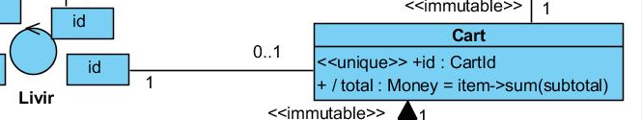

Preconditions establish what must be true when a system query or command is performed.

Slide 13

If the asociation was not qualified
cart->select(aCart | aCart.id = aCartId)->notEmpty()

Slide 14
Two families of preconditions
Parameter guarantee:
preconditions that assure that the arguments of a command or query correspond to valid objects. For example, “there exists a shopping cart with the id passed as argument”.
Complementary constraint:
preconditions that constrain even more the conceptual model when performing a given command or query, in order to assure that the information is in a given state when the operation is being executed. For example, “the cart has at least one item”.

Slide 15
The Rule for Finding Parameter Guarantee Preconditions
For each group of invalid values for a system operation parameter, a precondition or exception must be defined.

Slide 16
Parameter Guarantee Preconditions are not Syntactic
Use typing instead:
X:Integer
X:Natural
X:PrimeNumber

Slide 17
Complementary Constraints
Assures that certain constraints stronger than those of the conceptual model are obtained while a given command is performed

Slide 18
Three kinds of complementary constraints
A specific statement about an instance or about a set of instances.
An existential statement about a set of instances.
A universal statement about a set of instances.

Slide 19
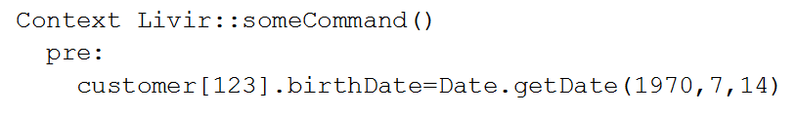
Specific Statement

Slide 20
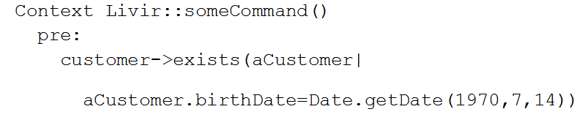
Existential Statement

Slide 21
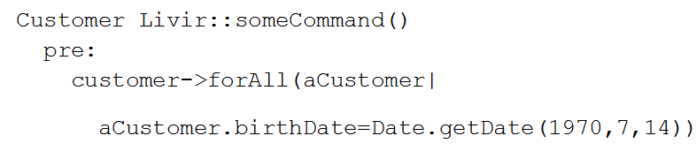
Universal Statement

Slide 22
Preconditions Assurance
As the preconditions are not tested by the command that declares them, an external mechanism should exist to assure that they will be guaranteed before the command is called.
That guarantee can be made by explicitly calling a query that verifies if the condition is true before calling the command, or by interface mechanisms that prevent the command to be called with invalid data.

Slide 23
Precondition and Exception versus Invariant
When an invariant already exists for a given situation, it is equivalent to the existence of an exception for any operation
However, an invariant does not work as a precondition
The existence of an invariant does not assure that the design does not violate it

Slide 24
Functional Modeling
Introduction
Preconditions
Query return
Post Conditions
Exceptions
Pattern Contracts for CRUD
Pattern Contracts for Listing Objects
Contracts Related to Use Cases

Slide 25
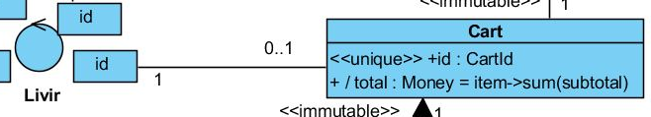
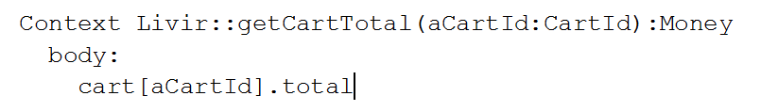
A query that returns the total of a given cart

Slide 26
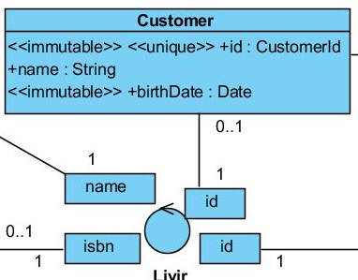
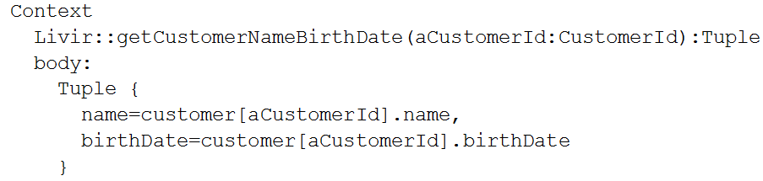
name and birth date of a given customer

Slide 27
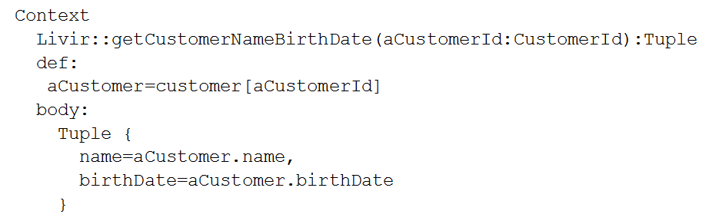
Using “def”

Slide 28
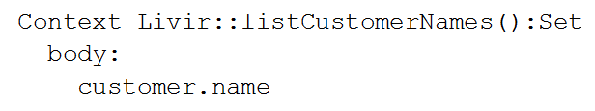
Projection

Slide 29
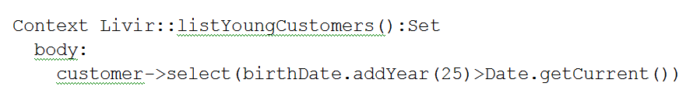
Filter and Projection

Slide 30
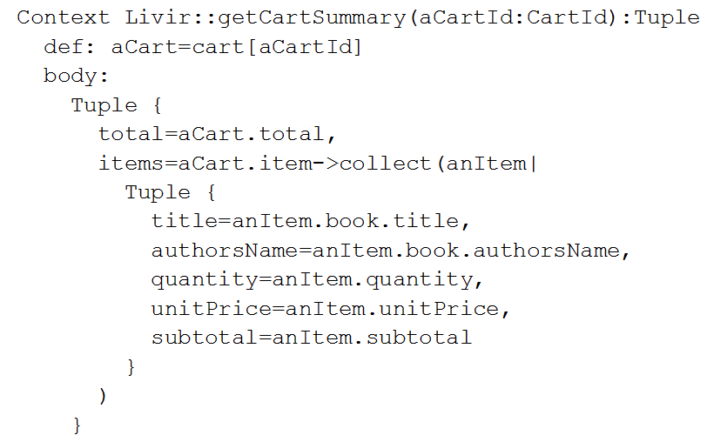
Cart Summary

Slide 31
Functional Modeling
Introduction
Preconditions
Query return
Post Conditions
Exceptions
Pattern Contracts for CRUD
Pattern Contracts for Listing Objects
Contracts Related to Use Cases

Slide 32
Types of Post Conditions
Change an attribute value.
Create a class instance.
Add an association link.
Destroy a class instance.
Remove an association link.

Slide 33

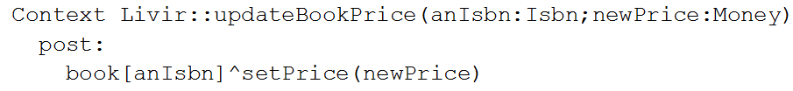
Changing an Attribute Value
Usual:
Proposed:

Slide 34
Creating an Instance
Usual:
Proposed:

Slide 35
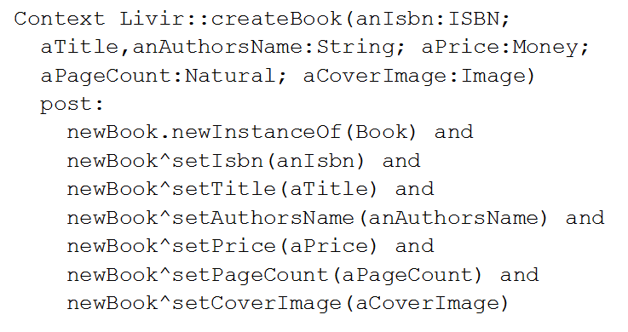
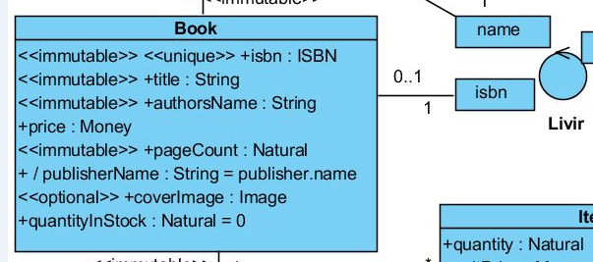
Create instance and initializing attributes

Slide 36

Adding a Link
Usual:
Proposed:
Or:

Slide 37
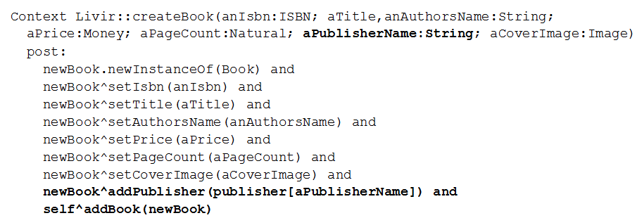
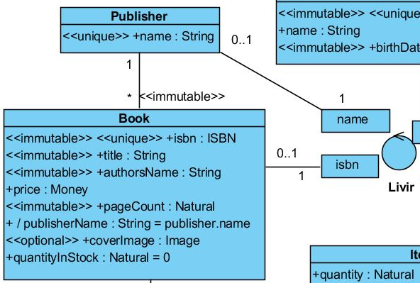
Complete Create Book

Slide 38

Destroying an Instance
Two approaches:
Implicit:
all associations to the object are removed so that it becomes inaccessible. In programming languages it is possible to implement garbage collection to remove from memory objects that are not accessible anymore.
Explicit:
it is declared that an object was destroyed by sending an explicit destruction message to it.

Slide 39
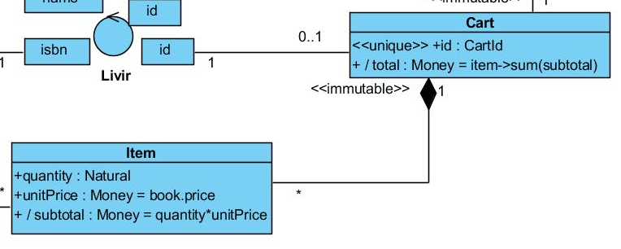
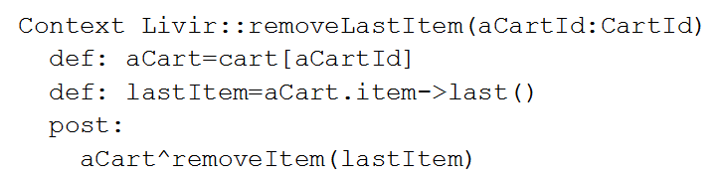
Removing a Link

Slide 40
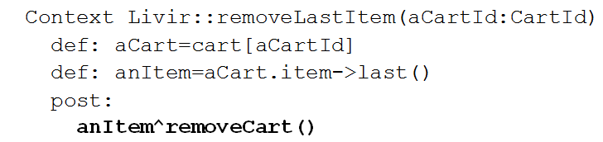
Role with multiplicity one does not need a parameter
However, both contracts leave the item inconsistent, because it has a mandatory association to Cart that does not exist anymore if the contract succeeds

Slide 41
Well Formed Post Conditions
A command that creates an instance must also have post conditions stating that all the instance attributes were initialized, except for:
(1) derived attributes (which are calculated),
(2) attributes with initial value (which are predefined by an init clause, unless a different value is desired), and
(3) optional attributes, which can be null (in that case, initialization is optional).
All mandatory links for a newly created instance must be added.
Even if it has no links associations a newly created instance must be linked to at least one instance that has a link path to the controller or linked to the controller itself.
All links created must stay within lower and upper bounds as defined by their association roles.
All invariants affected by changes in attributes, links or instances must be kept true.

Slide 42
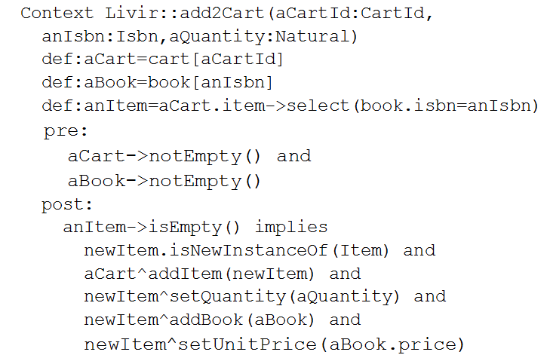
Implies

Slide 43
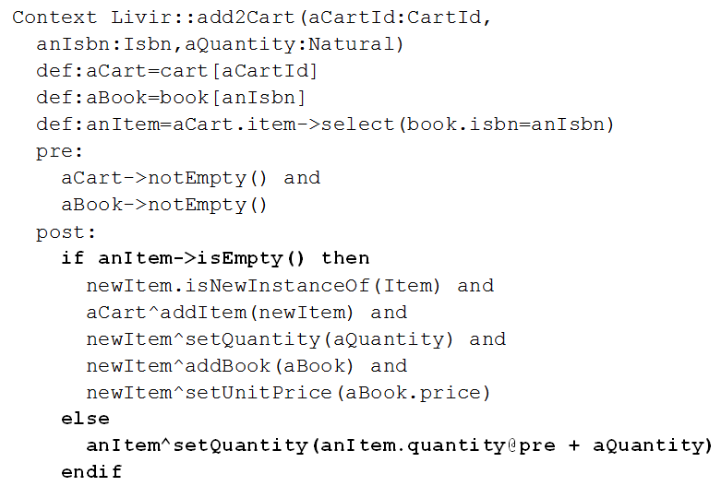
If then else

Slide 44
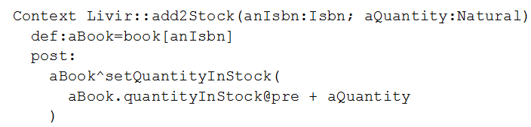
Former Values

Slide 45


Slide 46
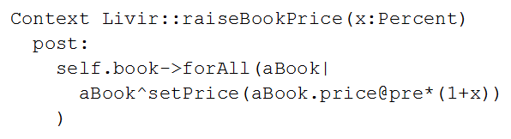
Post conditions over collections

Slide 47
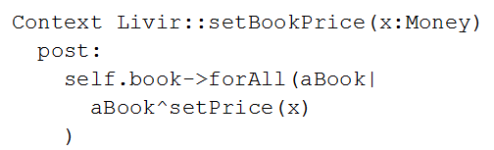
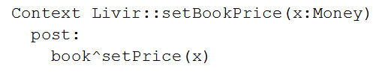
Abbreviated form (not always possible)

Slide 48
Functional Modeling
Introduction
Preconditions
Query return
Post Conditions
Exceptions
Pattern Contracts for CRUD
Pattern Contracts for Listing Objects
Contracts Related to Use Cases

Slide 49
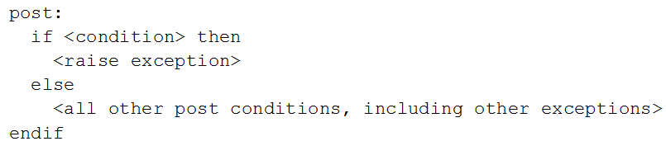

Exceptions
Usual form:
Proposed notation:

Slide 50
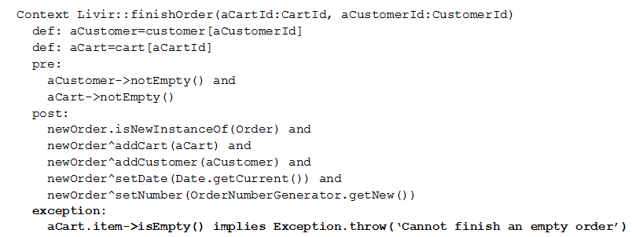
Complete contract with exception

Slide 51
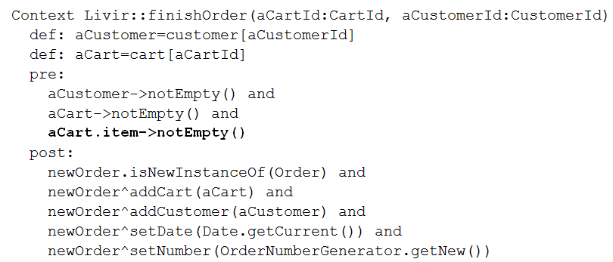
Exception converted into precondition

Slide 52
Functional Modeling
Introduction
Preconditions
Query return
Post Conditions
Exceptions
Pattern Contracts for CRUD
Pattern Contracts for Listing Objects
Contracts Related to Use Cases

Slide 53
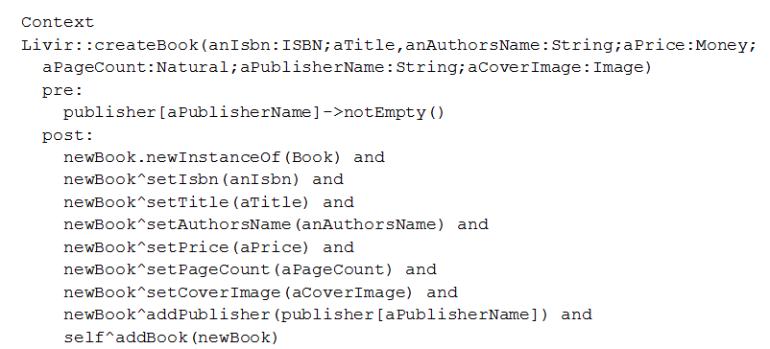
Create

Slide 54
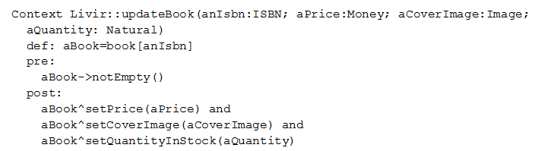
Update

Slide 55
Delete – approaches:
Assure by precondition that the object being deleted would not leave other objects inconsistent regarding the lower bound of their associations.
Using an exception to abort the delete command if it is tried over an object that will leave other objects inconsistent.
Assure by post condition that all objects that would be left inconsistent after deletion are deleted too.

Slide 56
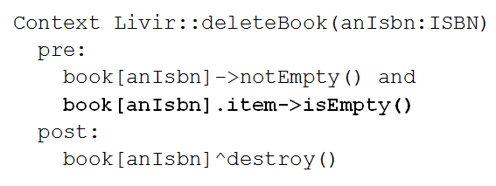
Delete – precondition approach

Slide 57
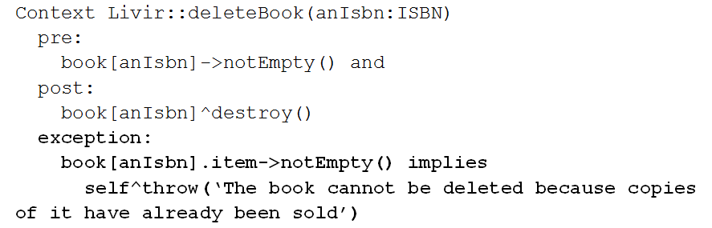
Delete – exception approach:

Slide 58
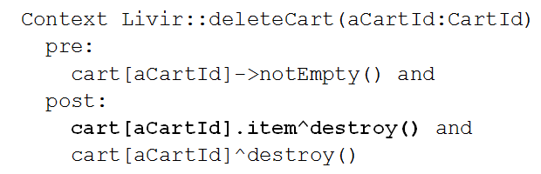
Delete – post condition approach:

Slide 59
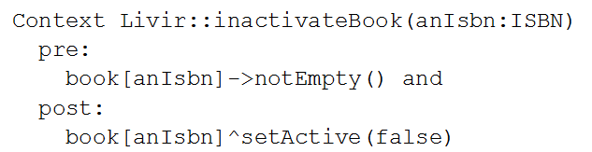
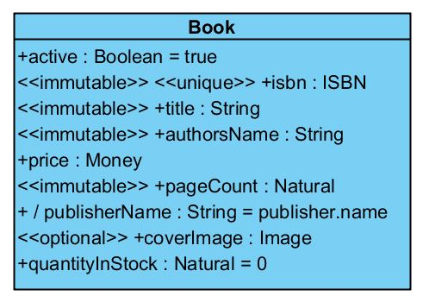
Delete – when instances cannot be really deleted:

Slide 60
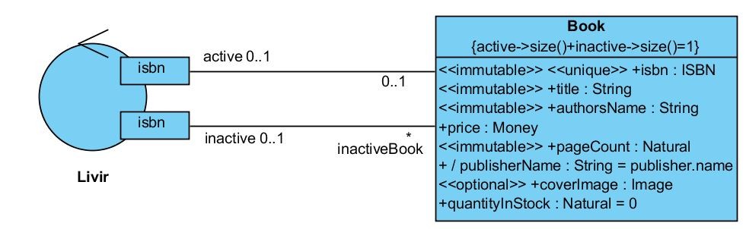
Alternate way to represent inactive books with two associations

Slide 61
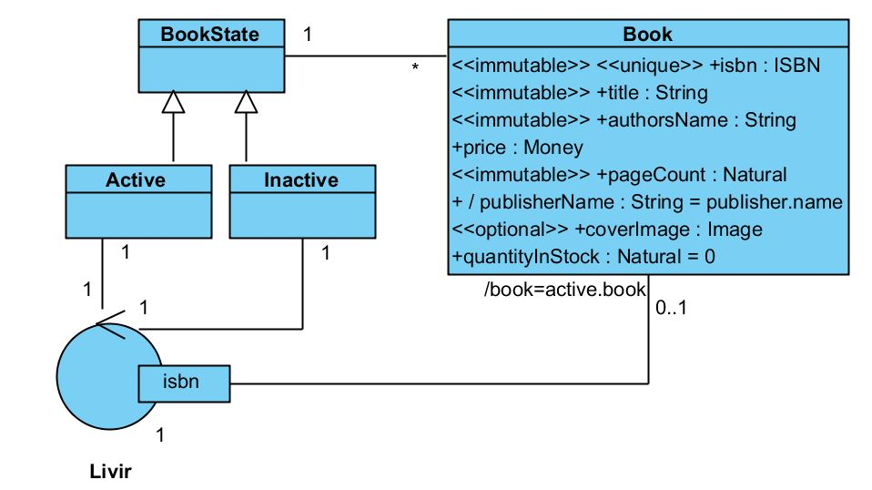
Another way to represent inactive objects by using the State design pattern

Slide 62
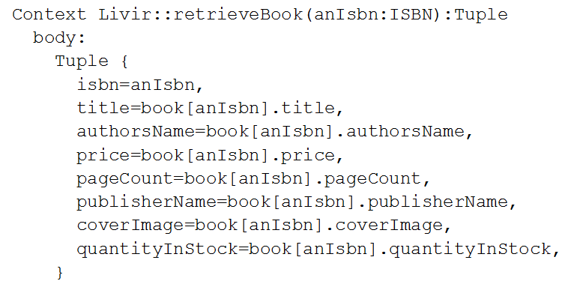
Retrieve

Slide 63
Functional Modeling
Introduction
Preconditions
Query return
Post Conditions
Exceptions
Pattern Contracts for CRUD
Pattern Contracts for Listing Objects
Contracts Related to Use Cases

Slide 64
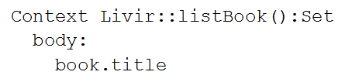
listing the title of all books available in the bookstore

Slide 65
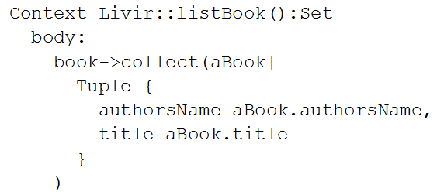
list with multiple columns

Slide 66
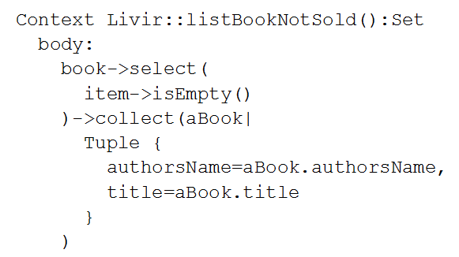
filter

Slide 67
Functional Modeling
Introduction
Preconditions
Query return
Post Conditions
Exceptions
Pattern Contracts for CRUD
Pattern Contracts for Listing Objects
Contracts Related to Use Cases

Slide 68
For each system operation you ask:
What is the goal of the operation?
What do they produce in terms of information?
What do they expect their predecessors have produced?
Which exceptions could happen during execution?
Can their exceptions be assured as preconditions?
Do their parameters include groups of values that are invalid?
Do the operations follow a known pattern?

Slide 69
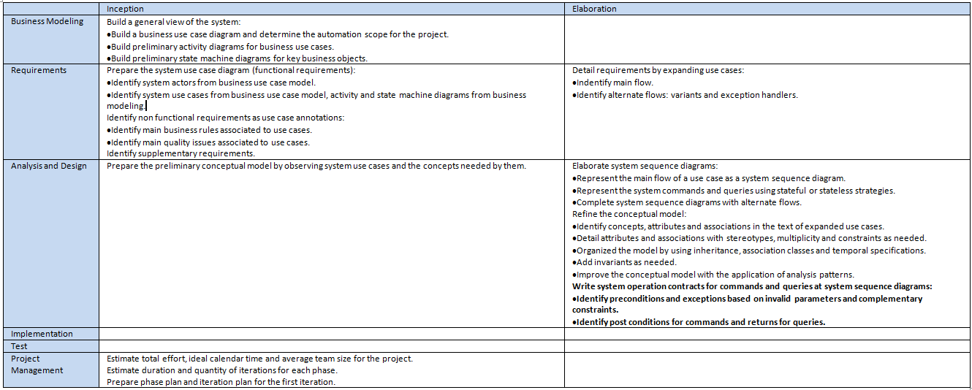
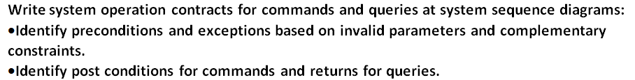
The process so far

Slide 70
Questions
Explain and present an example on how an exception may be transformed into a precondition and vice-versa.
What is the difference between exceptions in command contracts and in query contracts?
Which are the five possible post conditions, and which basic commands define each one of them? How can they be represented in OCL contracts?
Produce the contract for the query searchBook of Figure 8.2.

